Slide 1
Follow-Up intent & Fall-Back intent in Dialogflow
By Faheem Uz Zaman and Alifya Hussain

Slide 2
What is follow-up intent
Unlike conversation between humans, when building a CUI(Conversational UI), these follow-up statements in a conversation don’t come naturally. The developer has to consciously program the chatbot to be able to handle all of these follow-up statements.

Slide 3
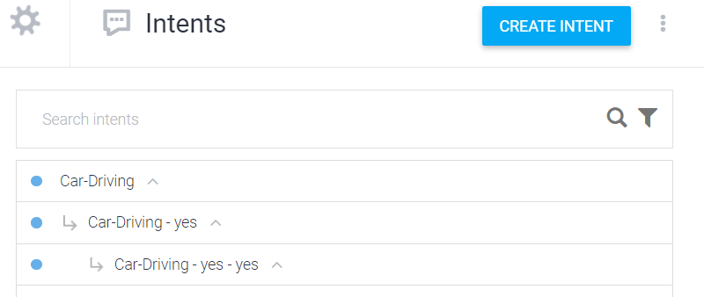
Follow-up intent looks like.

Slide 4
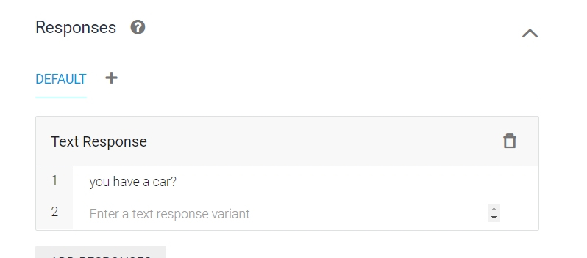
Intents in Follow-Up

Slide 5
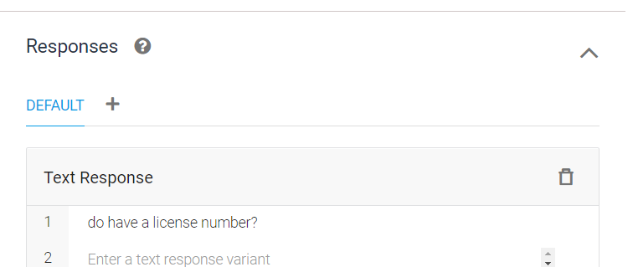
Intents in Follow-Up

Slide 6
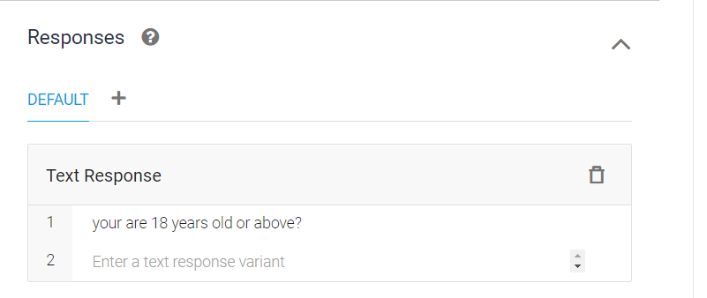
Intents in Follow-Up

Slide 7
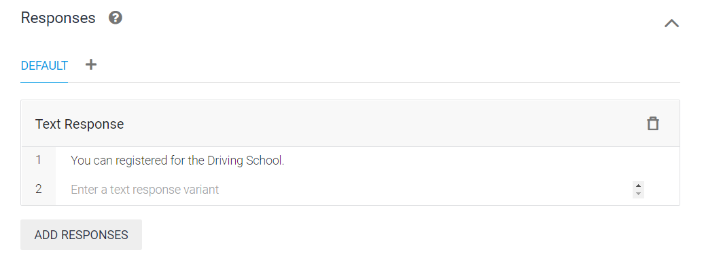
Intents in Follow-Up

Slide 8

Fallback Intents
The idea behind fallback intents is mostly the same as how they are defined in Dialogflow. There are two kinds – the “catch-all” fallback intent without any input context and the “context-based” fallback intent which does have an input context.

Slide 9
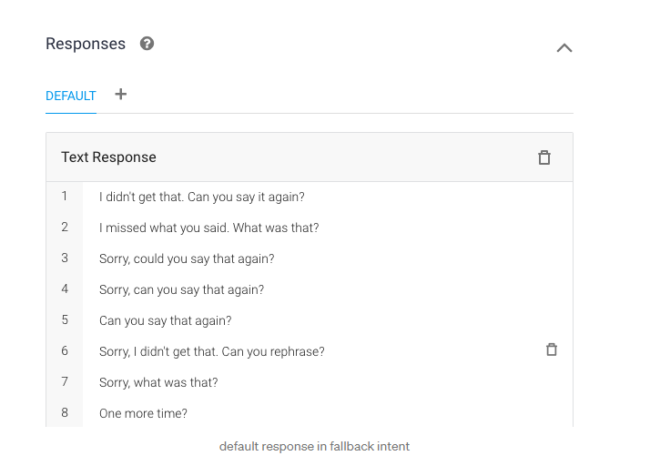
Fall-Back Intent

Slide 10
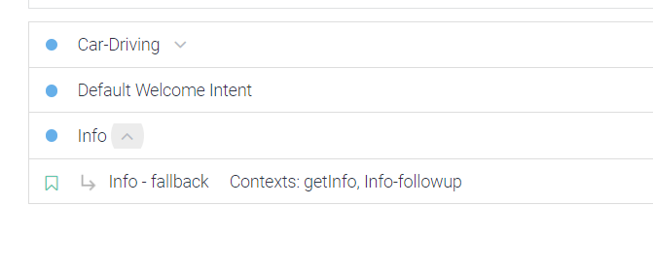
Intent Based Fall-Back or Follow-Up Intents

Slide 11
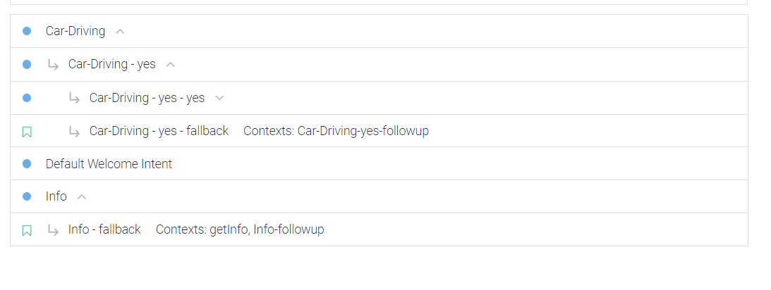
Intent Based Fall-Back or Follow-Up Intents

